Slide 1
Long-Term Electricity Price Prediction
Ashkan Yousefi
Maria Sheila Ramos,

Slide 2
Objective
Predict the monthly retail price of electricity 3-5 years in advance.

Slide 3
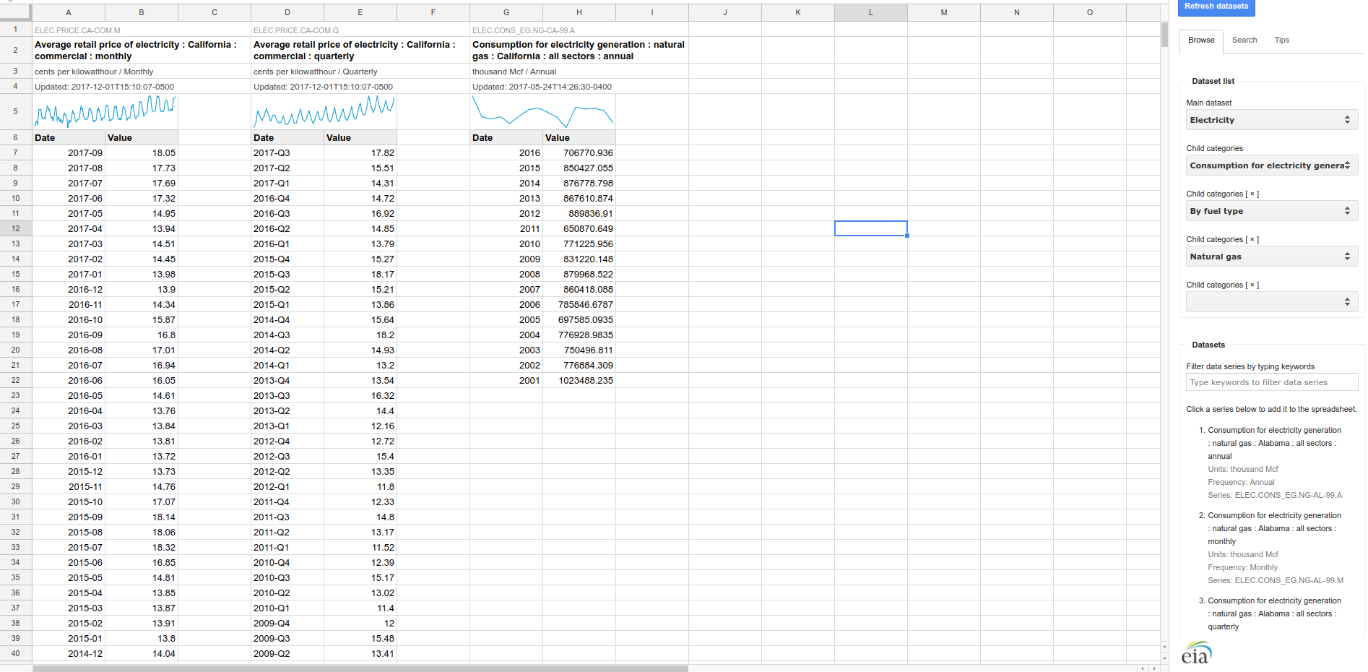



Data Collection and Cleaning
EIA “OpenData” Database
Biggest challenge was finding enough data.
Spent majority of time selecting, cleaning, formatting, and merging data.
Notes:
API - application programming interface
But thankfully, we found a database provided by the Department of Energy, constantly updated, with a nice API and accurate information.

Slide 4
Correlation Analysis
For feature selection

Slide 5
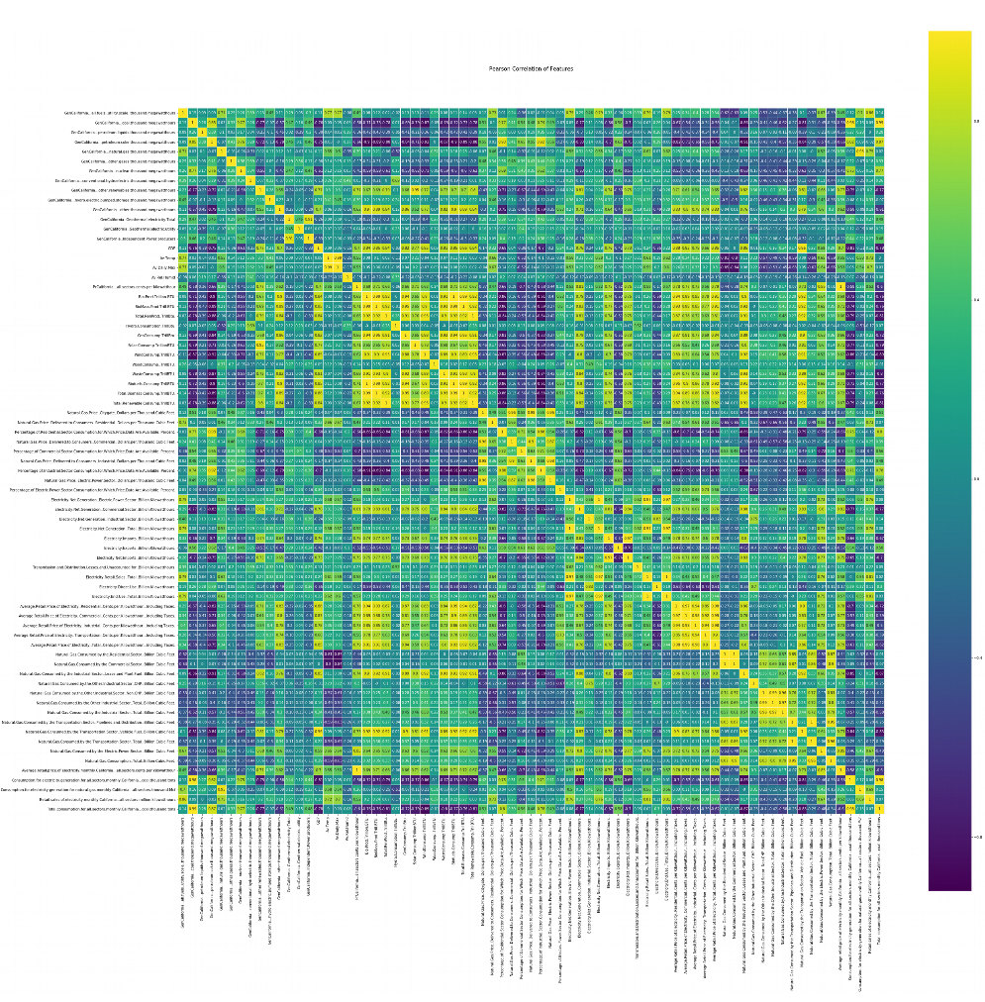
Notes:
This is looking at all sorts of energy production and usage statistics in different sectors, GDP, imports/exports, etc.

Slide 6
GDP
Renewables Consumption

Slide 7
Renewables Production
Bio
Geo
Solar
Wind
Hydro
Waste
Total Renewables

Slide 8
Natural Gas Price
Electricity Price
Different Sectors
Residential
Commercial
Inudstrial

Slide 9
Net Generation
Exports/Imports
in different sectors
Notes:
Correlated because in wintertime, as generation peaks, then consumption peaks and prices rise.

Slide 10
Natural Gas
Consumption and Production by sector.

Slide 11
Petroleum Coke
and Coal Generation

Slide 12
Correlations Summary (Features)
GDP (.7)
Natural Gas Consumed by Industrial Sector (.74)
Natural Gas Consumed by Electric Power Sector (.85)
Net Electricity Imports (.75)
Net Electricity Generation (.81)
Renewables (.77)
Solar Consumption (.71)
Geothermal Consumption (.65)
Wind Consumption (.62)
Biofuels Production (.72)

Slide 13
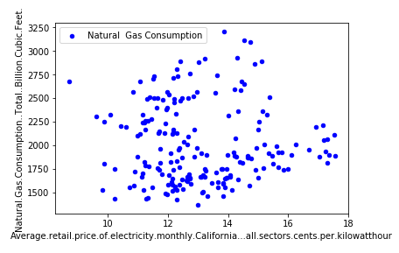
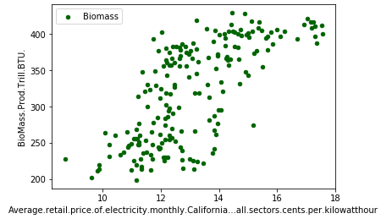
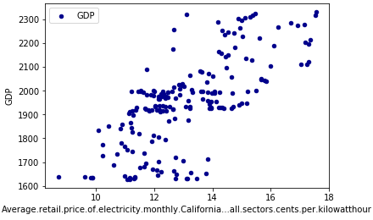
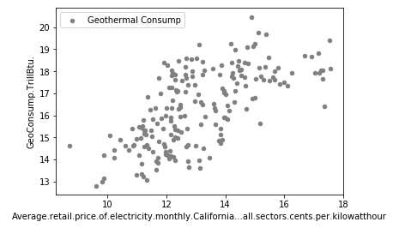

Slide 14
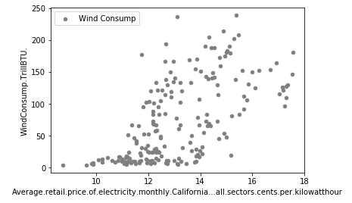
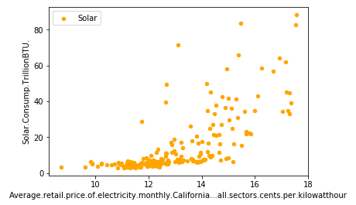
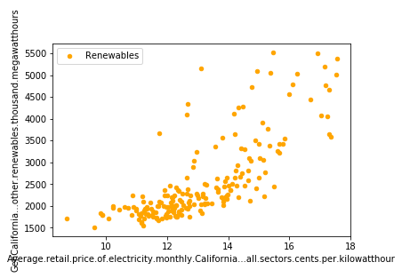
Notes:
But check this out. Why is this so interesting? Because it shows a potentially causal relationship.
From a macroeconomics perspective, renewables are not well-established like Oil, Coal, or Gas, all of which have thousands of non-quantifiable factors that come into play when determining price. It turns out that the main driver behind production and consumption of renewable energy is still people. Renewable production/consumption more or less goes up when people want it, and down when people don’t want it.
When electricity is cheap, there is no incentive for people to incur the heavy startup costs of buying $10,000+ solar solutions. And when electricity gets more and more expensive and solar adoption is the best in the country, then people feel comfortable switching to renewables because the math checks out, they save money.
There’s a behavioral economics angle to this, but it basically boils down to whether or not it’s worth it for people.
This shows that there is a quantifiable relationship between adoption of renewable energy and the price of electricity, and that is great news for our model! It basically means that, because of its relatively renewable-friendly climate, California energy prices can be a lot more predictable than probably the rest of the country.
Huge finding. More than a third of our features were renewables, so this really made prices in California much more predictable, and it’s definitely something that we can’t rely on for the rest of the country, so our model is really tuned for California.

Slide 15
Prediction
Time Series

Slide 16
Prediction with Time Series
Time Series Prediction (Autoregressive Integrated Moving Average or ARIMA) for 3 years - train 2000-2014, test 2014-2017, predict 2017-2020.
… for 5 years in advance - train 2000-2012, test 2012-2017, predict 2017-2022.

Slide 17
Time Series Results
Time Series Prediction for 3 years performed superbly.
Time Series for 5 years performed slightly worse, but still good.
Notes:
So here was the plan for prediction. After trying tens of different ideas up until literally the last second (Alex knows what we’re talking about), we started with a relatively simple time series prediction.

Slide 18
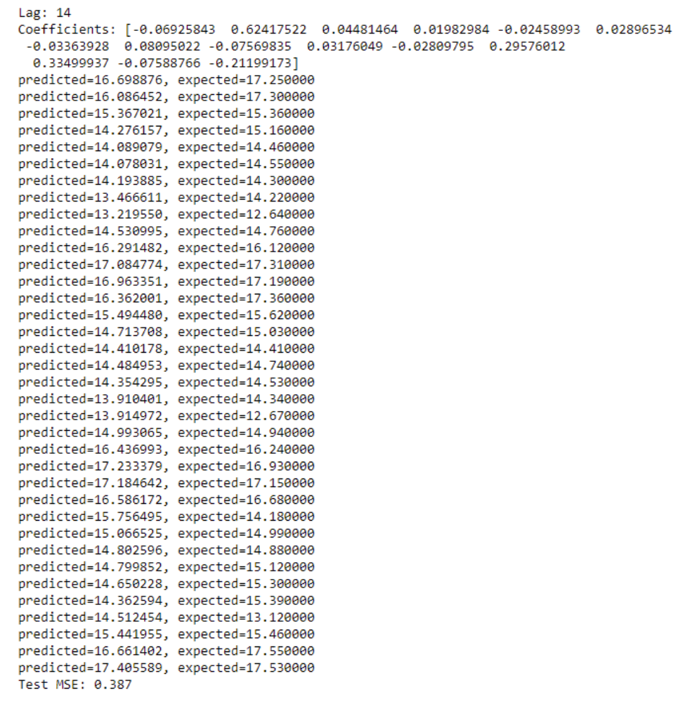
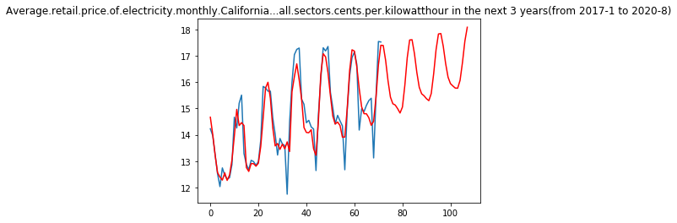
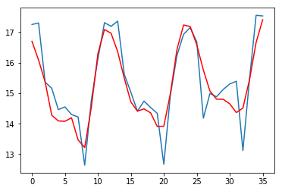
Average Monthly Retail Electricity Price (3 Years)
Cents per Killowatt-hour
Months
Notes:
Always within 1 Cent from True Values. These are, on average, off by .38 cents.
For 5 years, it works bad with an MSE of 4.972

Slide 19
Hand-Picked Features Model
Use Time Series to predict value of features in the future.
Train a model with the highest-correlated features.
Apply coefficients of tuned algorithm as weights to projected features.
Notes:
Treat Time Series prediction of feature data as synthetic data augmentation, train predictor on current features, predict based on projected features. Beat the 5 year.
SRIMA Model
GDP and Oil Supplies

Slide 20
Conclusions
3-Year Prediction
Time series model performed superbly.
Will investigate trained model with projected feature data next.
5-Year Prediction
Time series model did not perform great, but tuned model with time series predicted feature data performed much better.

Slide 21
Conclusions
So many factors can impact the electricity price:
Political Climate
Economic Climate
Corporate Decisions
Weather and Climate Patterns (next week at best)
Usage Patterns (next week at best)
OPEC
Foreign Policy
Notes:
Of course, despite all this, these are things that our model cannot capture explicitly right now, other than the trends being built into the last years’ data and being picked up automatically.
One thing we would like to do in the future, given more time and resources, is to look at a way to provide several estimates to be tuned with domain knowledge and perturbances.
Publication. Contact Iklhaq for help.
Common Filter
Rannaissance Technlogies - Weather in France for Stock prices in China (Importance of huge correlation matrix for finding seemingly unrelated data that ends up being really correlated).
ICO as a liquid representation of energy assets
Virtual Balance Sheet-less banking platform with self-enforcing contracts
Enhanced trust and security from blockchain
Backed by actual assets, anonymity
Courses:
Haas Energy Technology Course
Goldman School of Public Policy Energy Prediction Course

